Slide 1

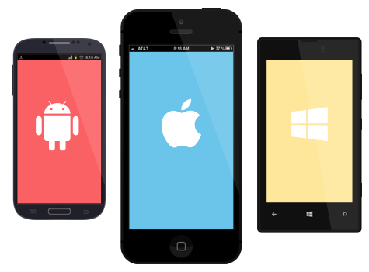
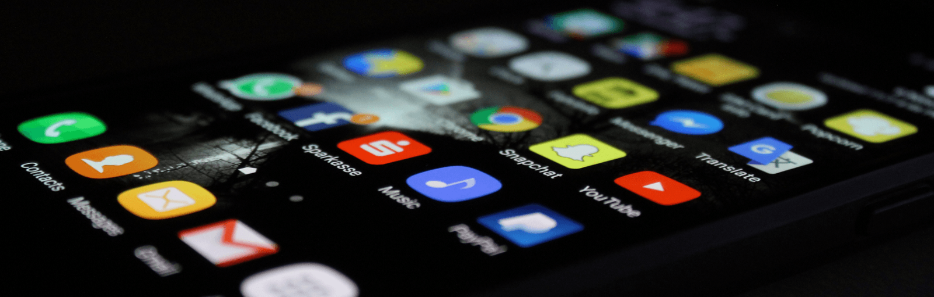
Introduction to Mobile programming
By
Dr. Izzad Ramli
Notes:
Assalamualaikum dan selamat sejahtera, Yang berusaha tuan Moderator En. Anuar dan penjaga bahagian teknikal En. Zul daripada matrikulasi Labuan..Pertama sekali terima kasih kepada pihak matrikulasi labuan dengan kerjasama dengan MDEC kerana menjemput saya untuk berkongsi sedikit sebanyak tentang ilmu yg saya ada untuk dikongsikan kpd adik2 semua. Inilah saya, jika tgk dari pakaian mcm nk berikan ceramah agama, tapi harini saya akan bercakap mengenai mobile app development and commercialization.

Slide 2
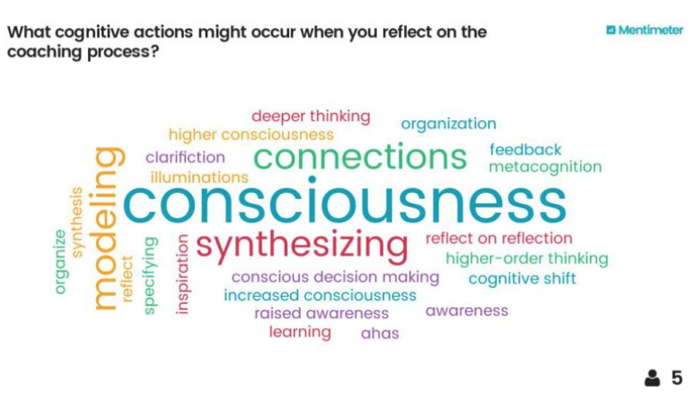
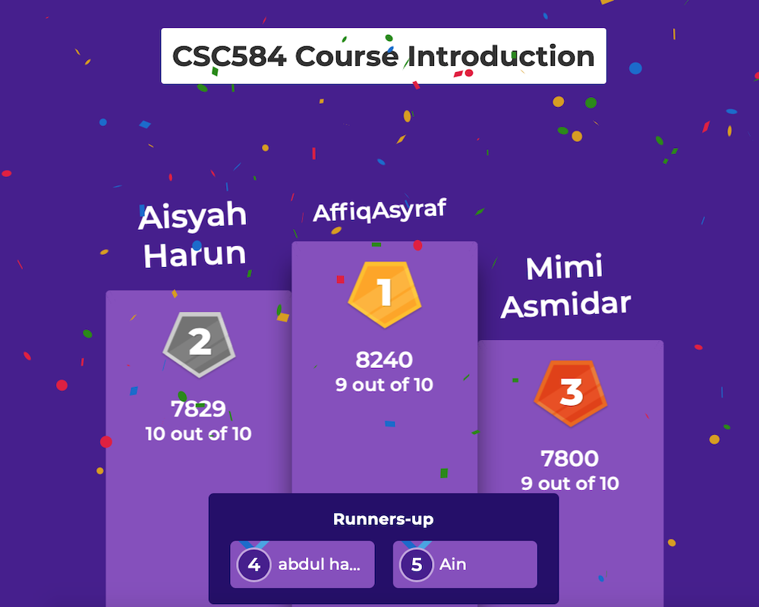
contents
Introduction
How to develop a mobile app?
How to gain profit from a mobile app?
Notes:
Sy tidak melihat berapa maklumat yang sampaikan, tetapi berapa banyak maklumat yang masuk.

Slide 3
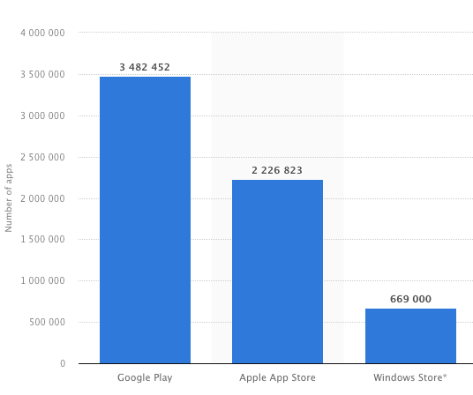
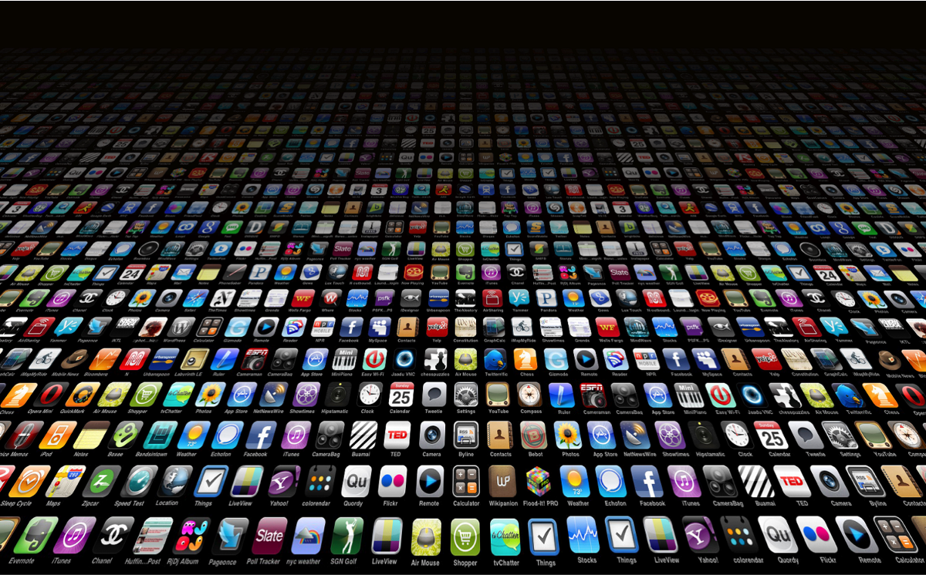
What is mobile app?
A mobile app or mobile application is a computer program or software application designed to run on a mobile device such as a smartphone/tablet or watch.
1st quarter 2021
Notes:
-Google play-samsung, vivo, huawei. ziomi
- Apple App store, iphone, ipad
-Window store - not really popular

Slide 4
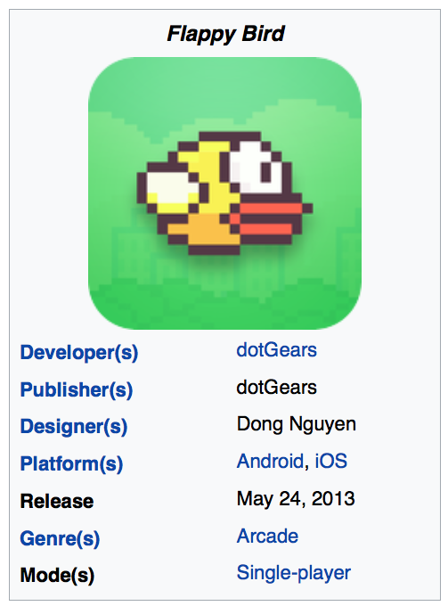
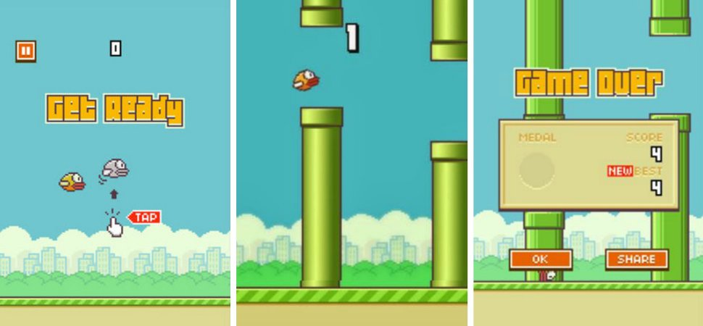
Flappy bird
Flappy bird
Flappy Bird is a mobile game by Dong Nguyen (Vietnamese video game artist and programmer).
Release May 2013, popular early 2014.
Received poor review for high level difficulty and graphics.
Other reviewers found it addictive.
Jan 2014, most download free game in App store for iOS.
Earning $50,000 a day in-app advertisement as well as sales.
Notes:
Semua tgk pada rezeki juga, usaha-kontraktor kerja teruk, pandai, professor kaya ke tidak, semua adalah rezeki.

Slide 5
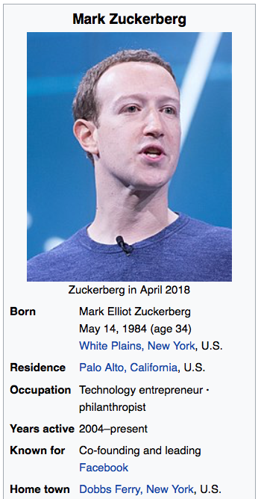
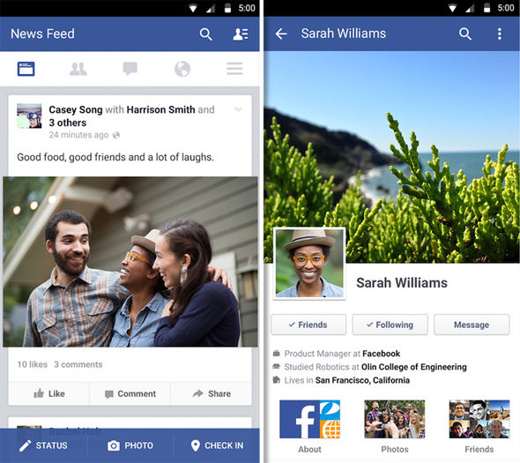
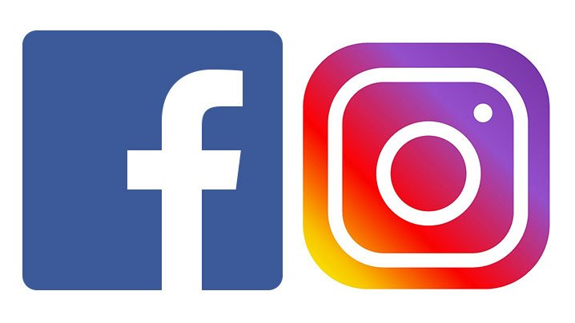
Facebook
Mark Elliot Zuckerberg launched Facebook from his dormitory on Feb 4, 2004, with others 4 college roommates.
Launched for college campuses but expanded rapidly to one billion users by 2012.
Net worth is estimated to be $55 billion as of 2018.
Age 23 become world’s youngest self-made billionaire.
Among 100 wealthiest and most influential people in the world.

Slide 6
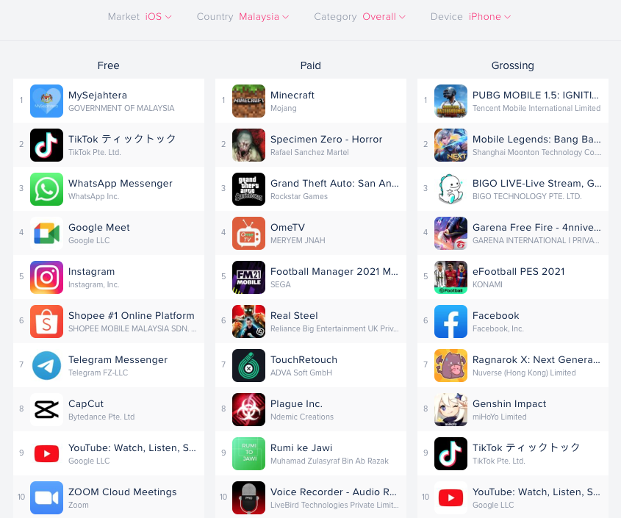
Top Apps on iOS, MALAYSIA, AUGUST 2021

Slide 7
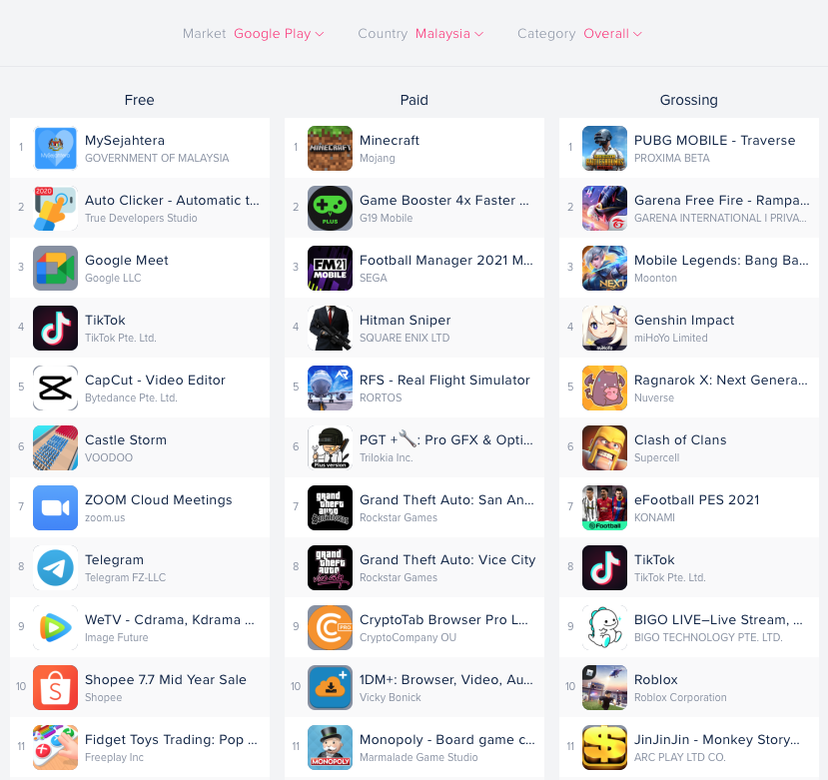
Top Apps on ANDRIOD, MALAYSIA, AUGUST 2021

Slide 8
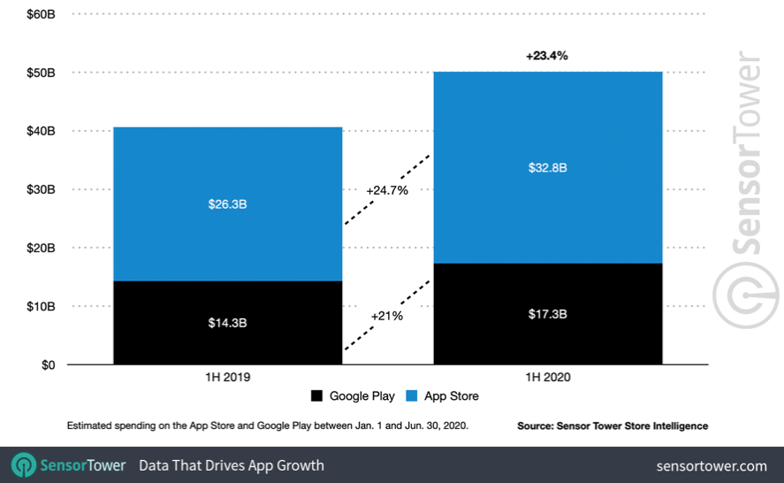
GLOBAL CONSUMER SPENDING IN MOBILE APPS AND GAMES FOR FIRST-HALF 2020

Slide 9
HOW TO DEVELOP A MOBILE APP?

Slide 10
PROJECT METHODOLOGY
TO DEVELOP AN APP
07
01
MAINTENANCE PHASE
IDENTIFICATION PHASE
06
MADLC
02
DEPLOYMENT PHASE
MOBILE APPLICATION DEVELOPMENT LIFE CYCLE
DESIGN PHASE
05
04
03
TESTING PHASE
PROTOTYPING PHASE
DEVELOPMENT PHASE

Slide 11
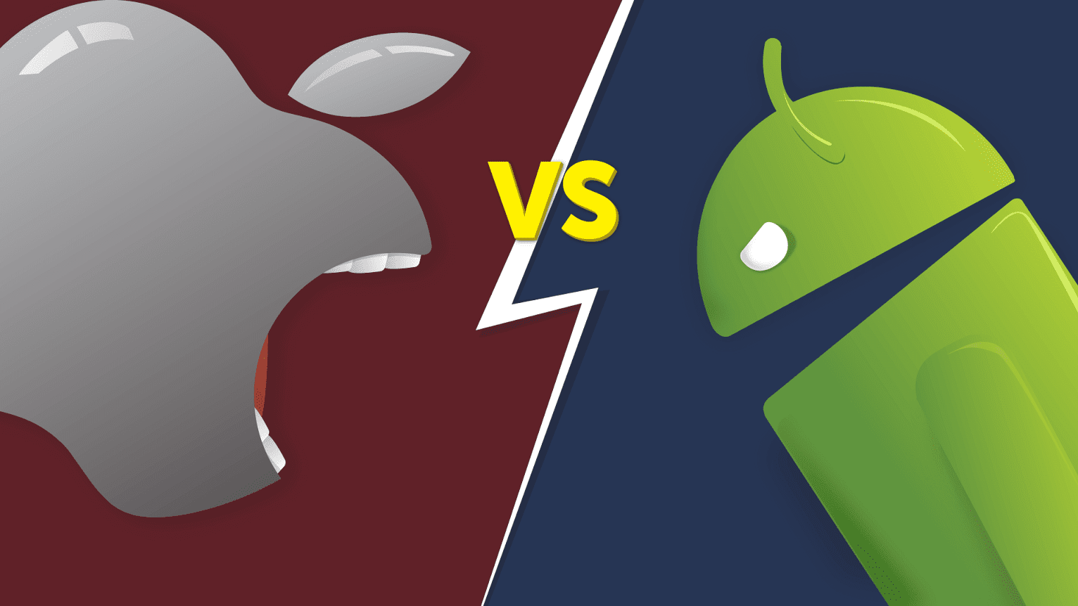
Andriod vs iOS: Which Platform to built your App for First?
PROJECT METHODOLOGY
01
TO DEVELOP AN APP
IDENTIFICATION PHASE
The choice comes down to 5 factors:
Audience.
Timeline.
Desired features.
Budget for maintaining your app.
Revenue goal.
It is risky and expensive to built an app for both iOS and android simultaneously.
Most developers choose to built an app for one platform to start and then launch the app on the other platform later once the first version is established and successful.

Slide 12
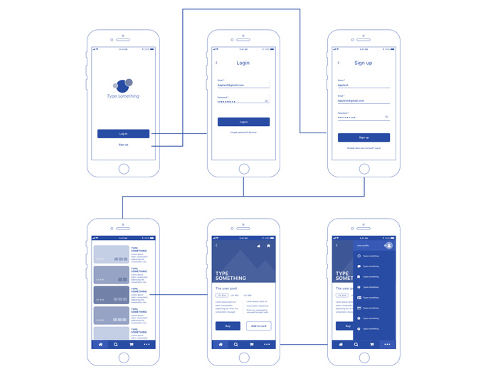
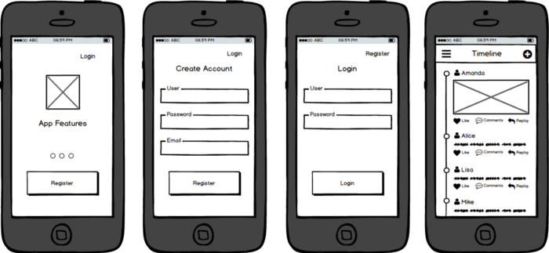
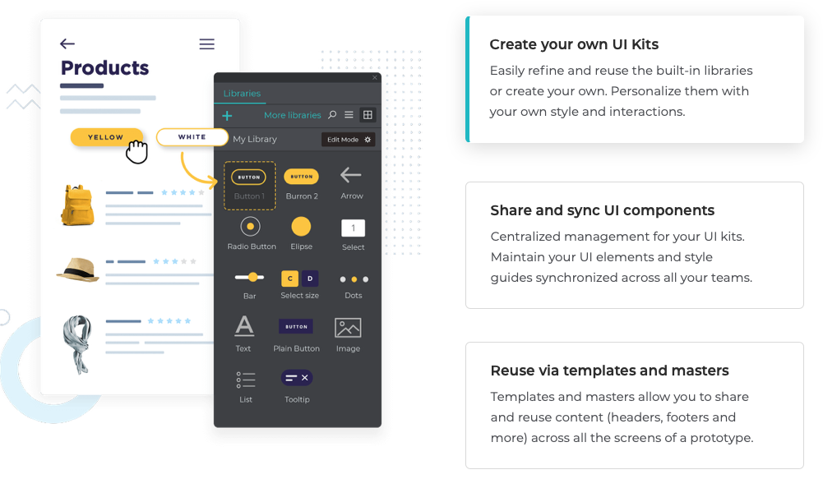
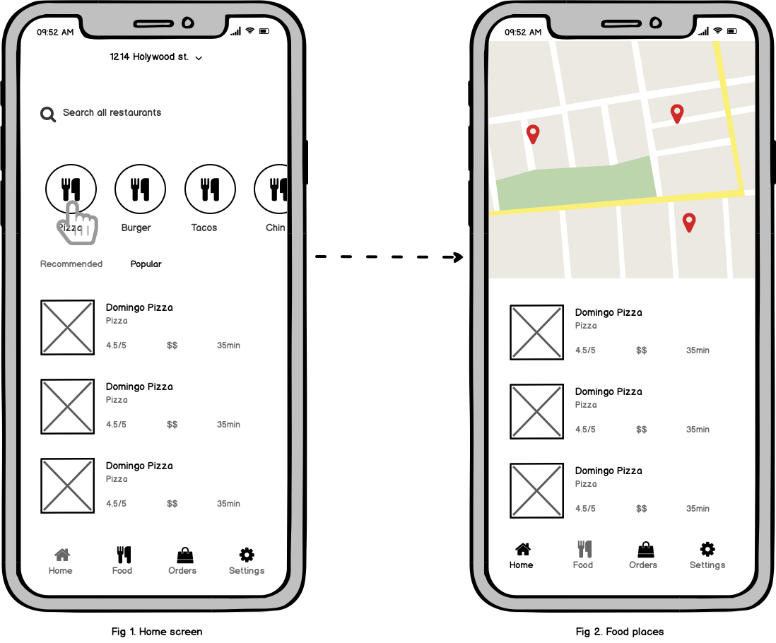
PROJECT METHODOLOGY
02
TO DEVELOP AN APP
DESIGN PHASE
Prototype design
Wireframe design

Slide 13
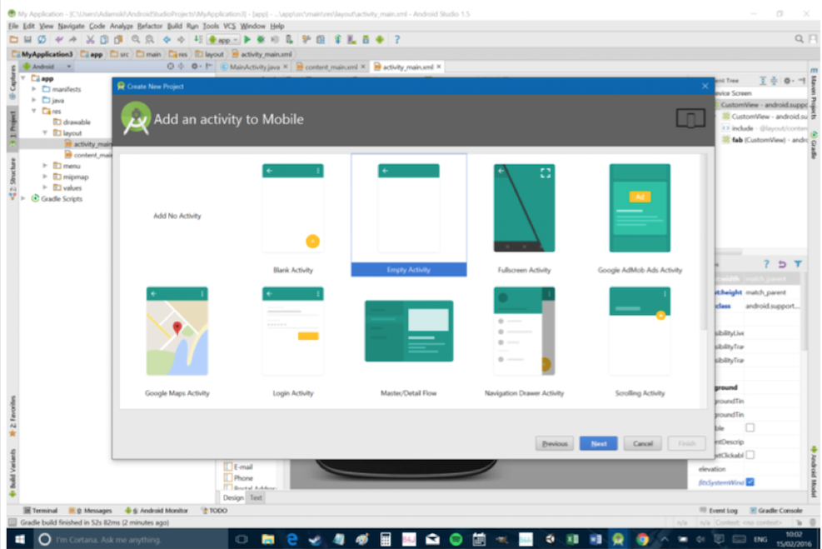
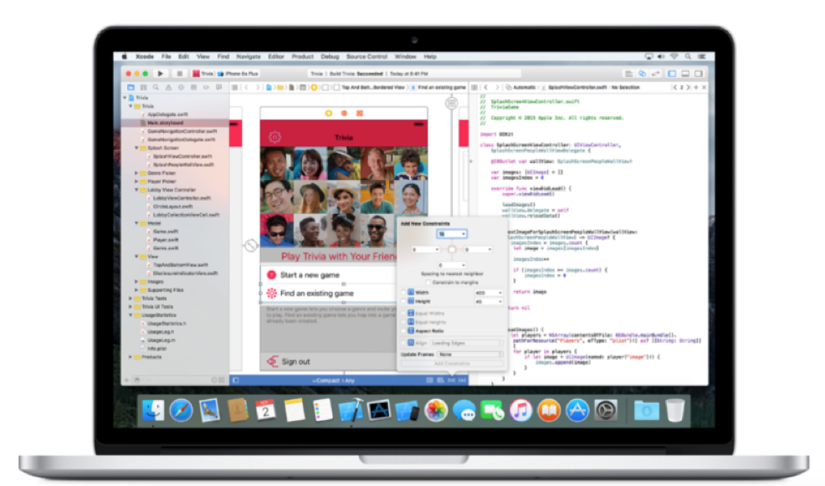
PROJECT METHODOLOGY
03
TO DEVELOP AN APP
DEVELOPMENT PHASE
Software for native app
Android Studio is the official IDE for Android development.
Java and Kotlin are the native language in android studio
Any hardware work.
Xcode IDE is the official Apple development experience.
Swift and Objective-C are the native language in Xcode.
Only on Mac.
Notes:
Mac operating system

Slide 14
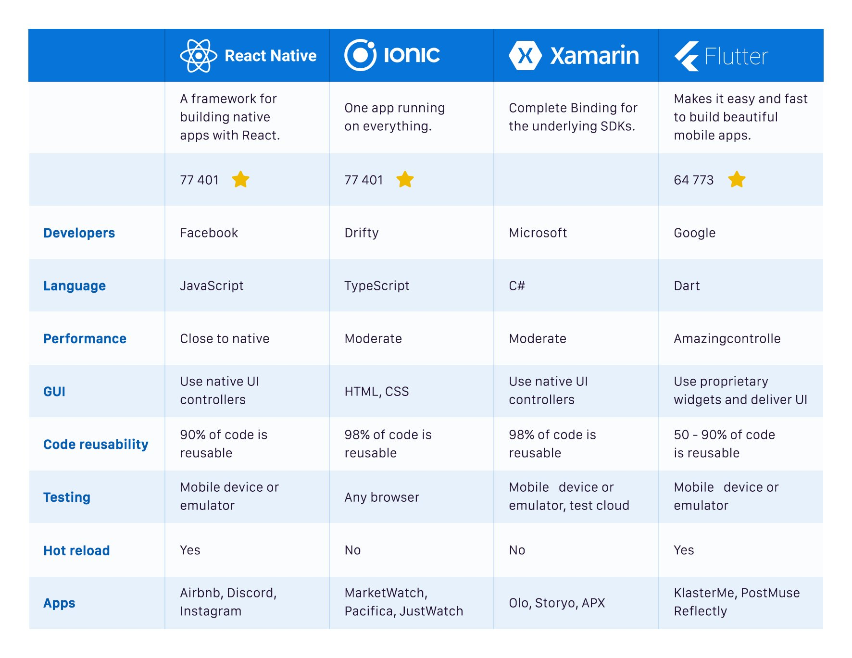
PROJECT METHODOLOGY
03
TO DEVELOP AN APP
DEVELOPMENT PHASE
Framework for hybrid app
Which framework
did you prefer?

Slide 15
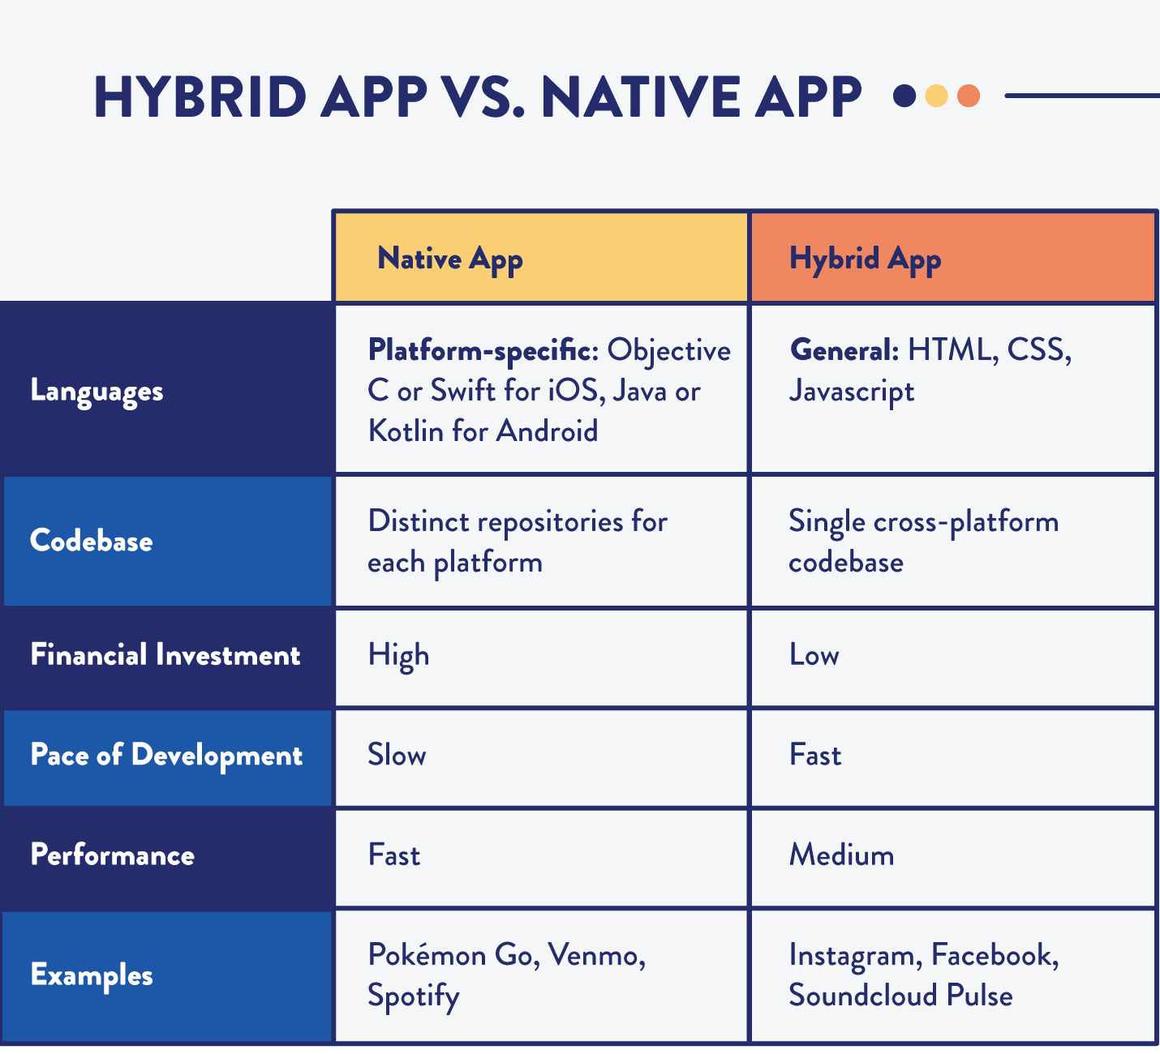
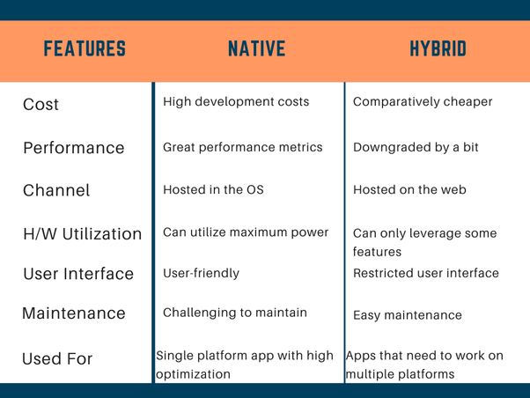
PROJECT METHODOLOGY
03
TO DEVELOP AN APP
DEVELOPMENT PHASE
Need to decide want develop app
using native or hybrid?

Slide 16
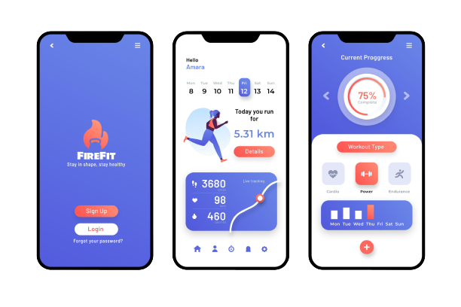
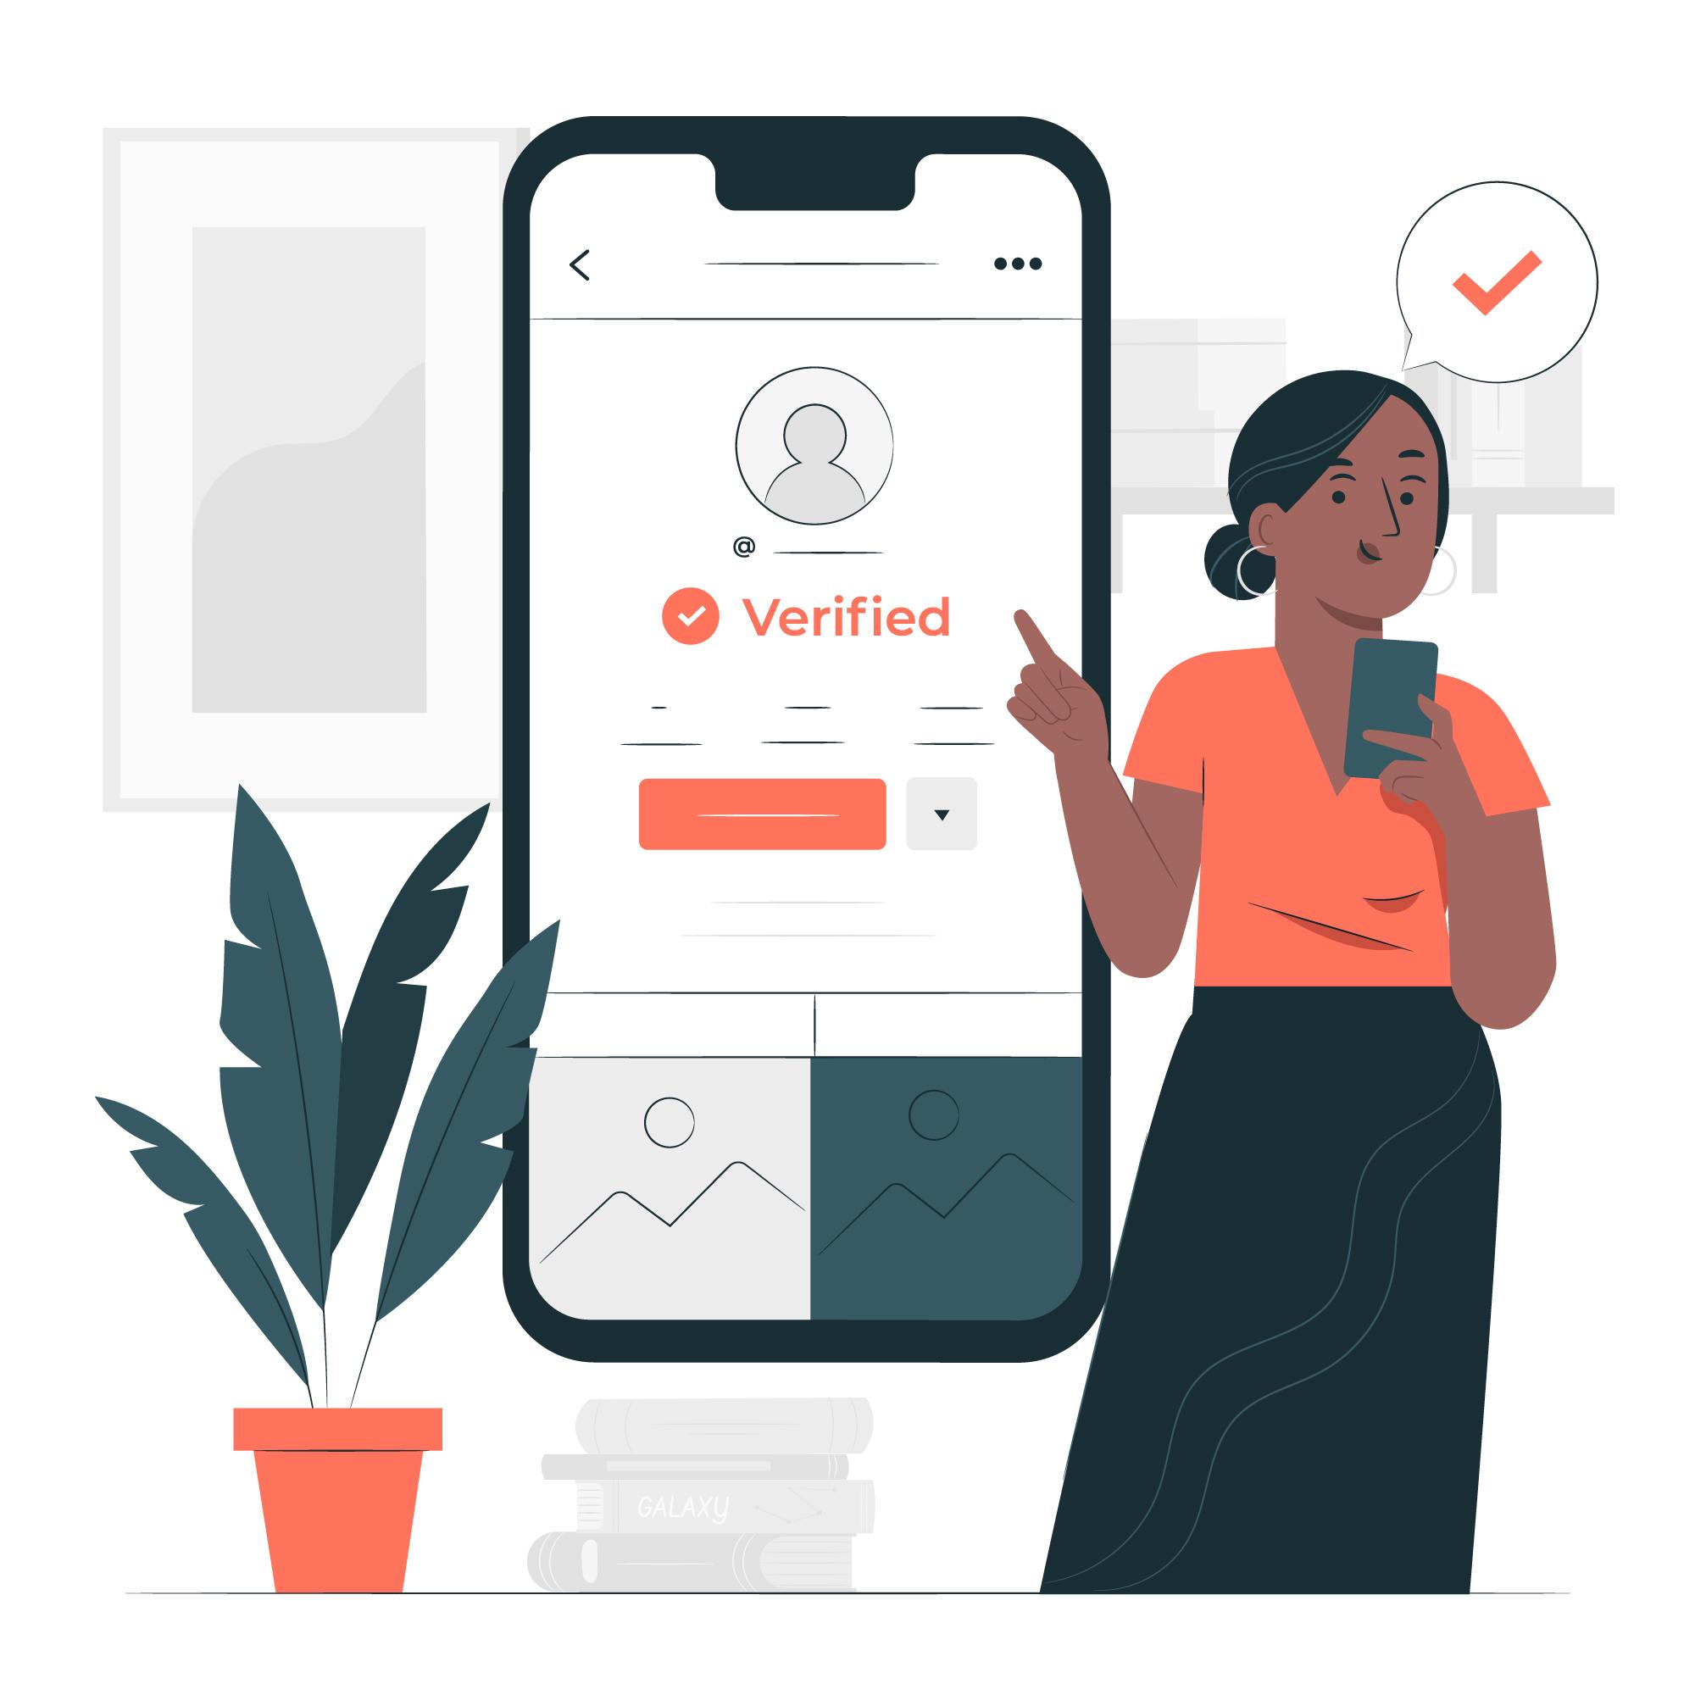
PROJECT METHODOLOGY
04
TO DEVELOP AN APP
PROTOTYPING PHASE
Functional requirements of the prototype are analysed, tested by developer
and sent to the client for feedback.

Slide 17
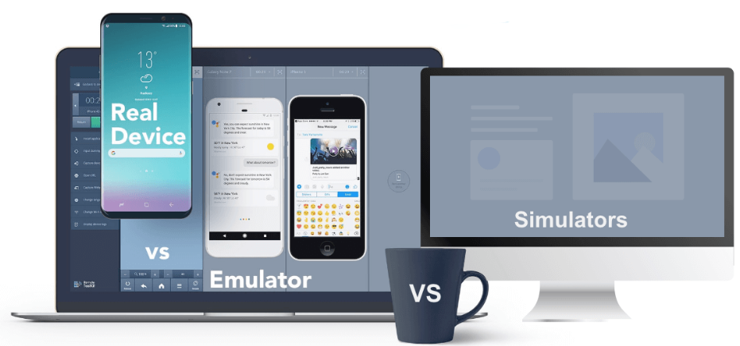
PROJECT METHODOLOGY
05
TO DEVELOP AN APP
TESTING PHASE
Testing performed on an emulator followed by
testing on the real device.
The development, prototyping and testing phases are repeated
until the final prototype is ready.
User Acceptance Testing (UAT)
Functionality test
Usability test

Slide 18
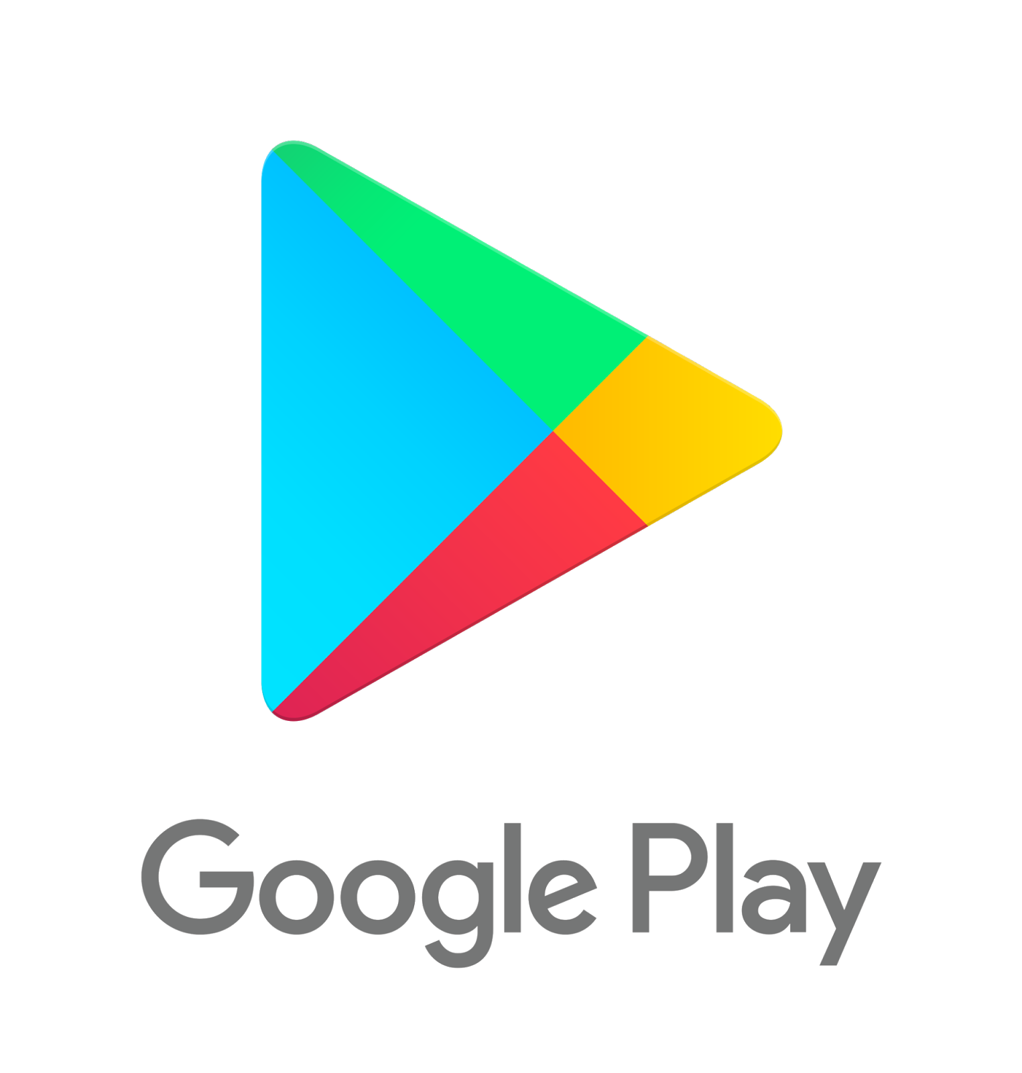

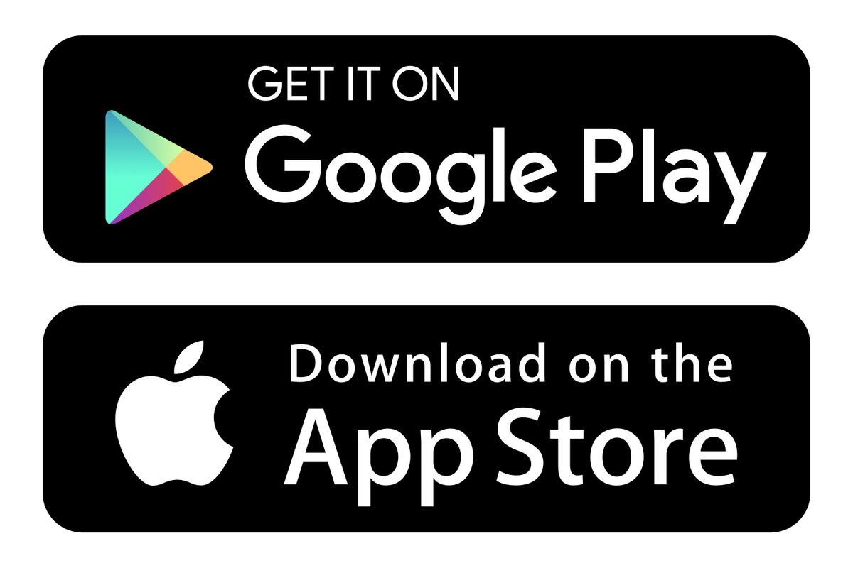
PROJECT METHODOLOGY
06
TO DEVELOP AN APP
DEPLOYMENT PHASE
Cost
For iOS developer program (App Store), you will need to pay $99 (RM400) per year as an individual developer or $299 (RM1,200) as a company.
Andriod charges $25 (RM100) only once (Play Store), without any limitations as to the number of published apps.
Approval time
It usually takes a few hours for Google to approve and publish
In the app Store, there’s a committee of a real people who check your app follows all the guidelines. This process up to a week but now is about a day.
App Store

Slide 19
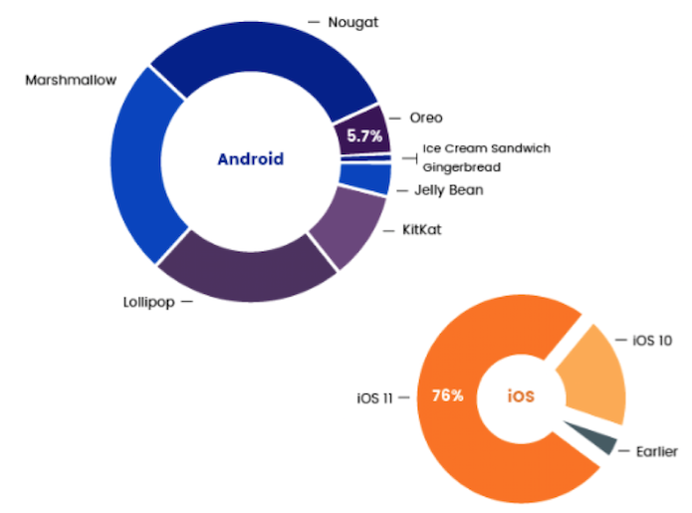
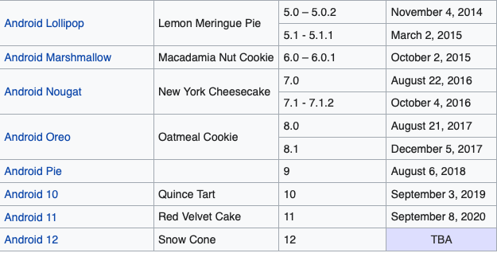
PROJECT METHODOLOGY
07
TO DEVELOP AN APP
MAINTENANCE PHASE
Ensuring your app remains compatible with the platform and avoiding bugs and crashes for users running older operating systems.
Andriod users are slower to adopt new operating systems – Over 50% of android users were running an operating system more than 2 years old.
Current is android 11
Andriod and iOS latest mobile OS version market share (early 2018)
Current is iOS 14

Slide 20
HOW TO GAIN PROFIT FROM A MOBILE APP?

Slide 21
Business model for an app
1) Freemium.
2) Virtual goods with in-App Purchase (The Addictive Model).
3) Advertisement and sponsorship.
4) Paid apps.
5) In-App Affiliate Marketing.

Slide 22
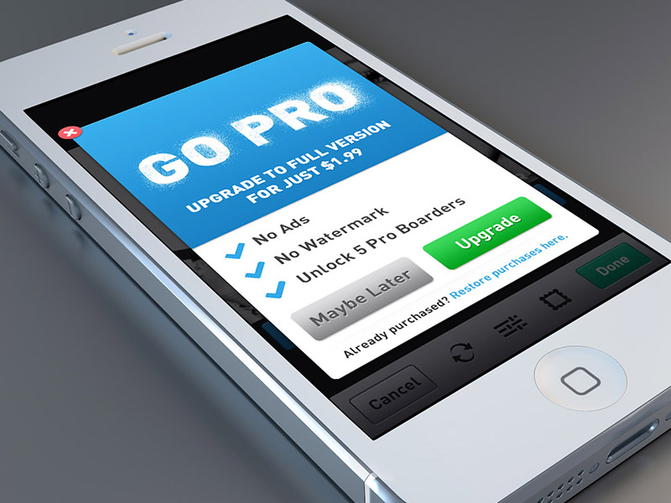
Business model for an app…
Freemium
Limited version of your app to user and encourage them to buy full version.
“Free” app more accessible and customer more willing to download without thinking it over.
Dropbox app offers user 2GB of storage for free and allows them to buy more storage space if needed.
Temple run and Fruit Ninja have used freemium model and encourage the users to upgrade their apps to avoid advertisements.
Don’t require thousands of install in order to generate revenue.

Slide 23
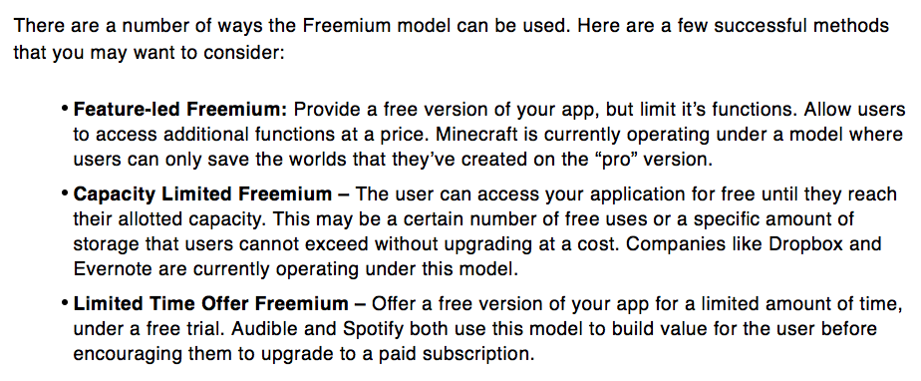
Business model for an app…
Freemium

Slide 24
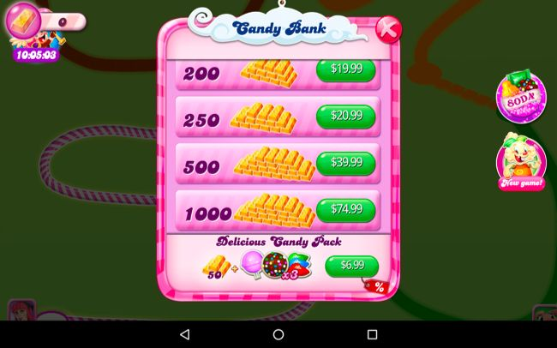
Business model for an app…
2. In-App Purchase
Popular monetization model especially for mobile games.
Success game like FarmVille and The Sims allowing using this model because of its simplicity, versatility and scalability.
To succeed this model, all you need is an addictive app allow users to advanced their value with some type of in-app virtual goods.
In-app purchase such as ability to buy credits, move, characters, levels and so on.
Require a considerable numbers of users.
Sometimes one strong in-app purchase option more provide significant value.

Slide 25
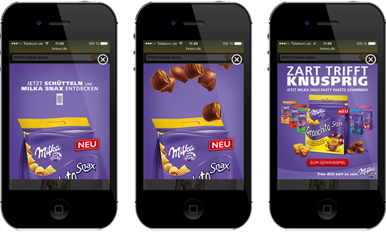
Business model for an app…
3. Advertisement and sponsorship
Advertisement can have a dramatic effect on user experience.
Extremely large base of users who interact with the app frequently.
As an example, your app receive $1 for each 1000 impressions, it would take 1000 users viewing ads on a single occasion or 500 users viewing ads twice.
Your income based on how large you can grow your audiences.
Usually, the advertisement along with other monetization methods to maximize the monetization of each of its users.

Slide 26
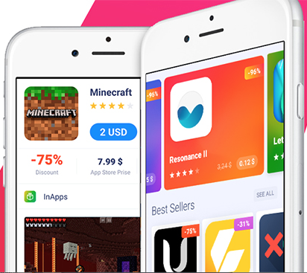
Business model for an app…
4. Paid apps
Offering download for payment.
Startup earn a revenue every time a user purchases their app.
One-time payment, user given access to the app forever.
It’s also very difficult to get potential users to purchase an app.
App store and Play Store are highly competitive and many free apps out there.
Study shows that paid apps are install 90% less than free apps.
Successive paid apps generally rely on having strong brand presence other marketing channels (print, digital, social media, email).
Small app need to prove themselves because customers trust that their money will be well spent even it’s only a dollar.

Slide 27
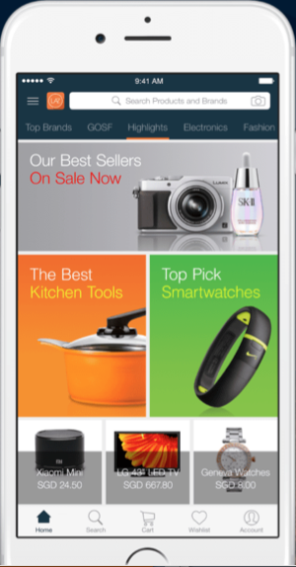
Business model for an app…
5. In-App Affiliate Marketing
Allows you to advertise and sell third-party products to your audience.
Earn commission on the sale.
Such as Lazada, Lelong, Mudah, and so on.

Slide 28
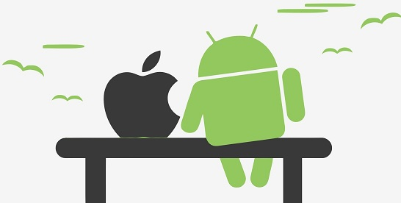
Thanks
“Never give up. Today is hard,
TOMORROW
will be worse, but the day after tomorrow will be
SUNSHINE.”
- Jack Ma-

